Slide 1

STEGANOGRAPHY IN ACTION- IMAGE STEGANOGRAPHY
BY
PRIYADARSHINY DAS
Techno Main Salt Lake
B.Tech in Computer Science And Engineering- Cyber Security (2024-2028)
12/10/2025
Annual Review
‹#›

Slide 2

PROBLEM STATEMENT
Sensitive information often needs to be communicated discreetly across public channels, but traditional encryption makes this very act of communication noticeable, raising suspicion and potentially flagging the message for interception. Therefore, a proper solution must be found to securely transmit data such that its existence is completely concealed, making the communication seem innocuous and undetectable by a third party.
12/10/2025
Annual Review
‹#›

Slide 3
Project Description
This image steganography web app is a simple, client-side web application for hiding and revealing secret text messages within and from images respectively using LSB (Least Significant Bit) steganography. This tool allows users to embed messages in PNG, JPG, or JPEG images and retrieve them securely, with optional password protection.
LOGIC AND ALGORITHMS
  Steganography Method: Least Significant Bit (LSB) substitution. The app modifies the least significant bits of the RGB channels in image pixels to encode binary data. This is imperceptible to the human eye but recoverable with the correct key.
  Encryption: Optional XOR (exclusive OR) encryption with a user-provided key. The key is repeated cyclically to match the message length. If no key is provided, the message is hidden in plain binary.
  Hiding: Prepends a 32-bit binary length prefix to the message, encrypts the whole with XOR, and embeds it in LSBs.
  Revealing: Extracts LSBs, decrypts with XOR, reads the length prefix, and slices the exact message.
  Capacity Check: Ensures the image has enough pixels (3 bits per pixel) to hold the data; alerts if the message is too long.
  Error Detection: Validates extracted data; shows errors for wrong keys, corrupted images, or insufficient data.
12/10/2025
Annual Review
‹#›

Slide 4

WHO ARE THE END USERS?
POTENTIAL END USERS
1. Privacy-conscious individuals (casual users): To send personal notes, sensitive passwords, or confidential account numbers to family, friends, or colleagues where a simple encrypted message might look suspicious.
2. Digital artists and content creators: To apply a hidden watermark or copyright notice into an image before uploading it online, proving original ownership without visually cluttering the artwork.
3. Journalists and activists (in low-risk scenarios): To discreetly share non-critical but sensitive information or meeting coordinates with sources or colleagues, making the communication appear as just an ordinary picture.
4. Students learning about cybersecurity: To experiment and grasp the core concept of Least Significant Bit (LSB) substitution and how data can be concealed.
5. Individuals bypassing basic content filters: To send short messages that might be flagged by basic keyword filters if sent in plain text (e.g., specific URLs or forbidden terms).
12/10/2025
Annual Review
‹#›

Slide 5

Technology Used
TECHNOLOGIES AND LANGUAGES
  HTML5: Structure of the web app, including forms, dropzones, and UI elements.
  CSS3: Styling with modern features like backdrop-filter for glassmorphism, flexbox for layout, and responsive design.
  JavaScript (ES6+): Core functionality, including Canvas API for image processing, event handling, and steganography logic. No external libraries were used (for simplicity and performance).
BROWSER APIs
  Canvas 2D API for reading/writing image data.
  File API for handling uploads and downloads.
  Blob API for generating downloadable images.
  No Server-Side: Pure client-side app; runs entirely in the browser. Compatible with any modern browser supporting ES6+ and Canvas.
12/10/2025
Annual Review
‹#›
Notes:
5

Slide 6
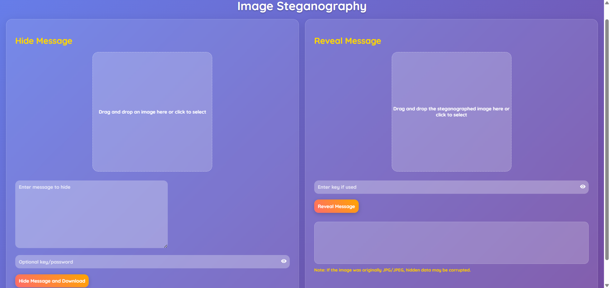
RESULTS
GitHub Link: https://github.com/PERSONAL-PROJECTS-2000/STEGANOWEB.git
12/10/2025
Annual Review
‹#›

Slide 7
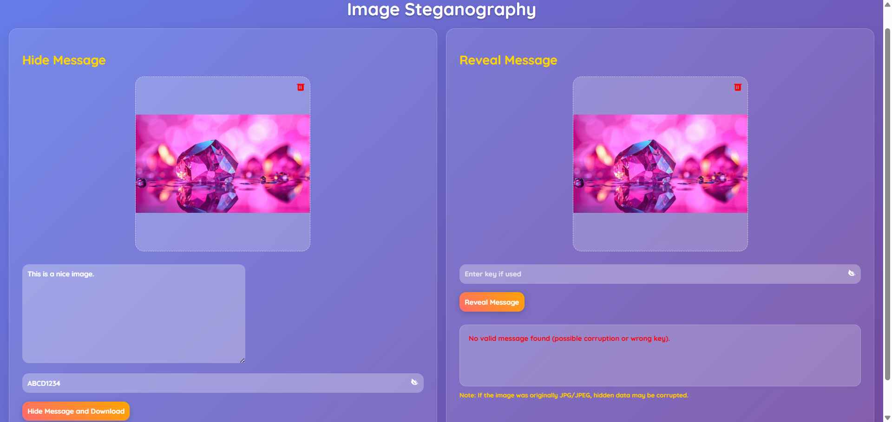
12/10/2025
Annual Review
‹#›

Slide 8
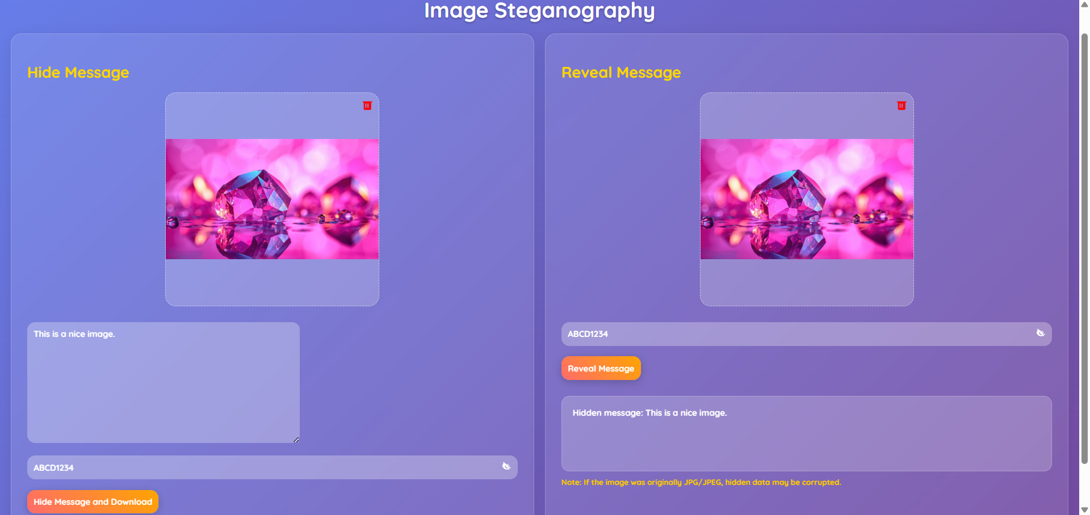
12/10/2025
Annual Review
‹#›

Slide 9

12/10/2025
Annual Review
‹#›

Slide 10

12/10/2025
Annual Review
‹#›

Slide 11
Thank you
.
.
12/10/2025
Annual Review
‹#›

